Slide 1

AB Test Project
Ting Yao

Slide 2

Goal of Optimization
Deliver an experience that is
Straightforward
Easy to understand

Slide 3

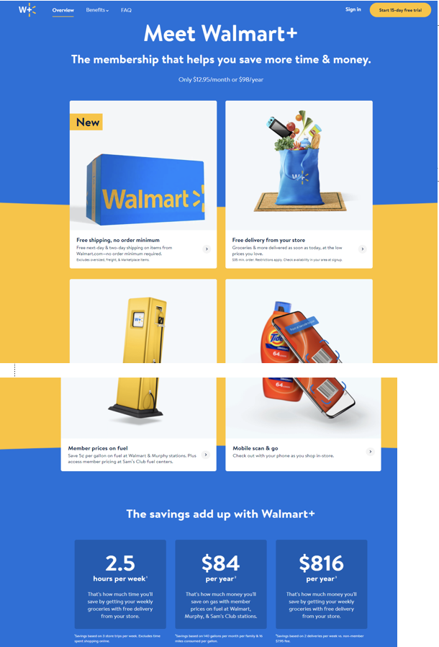

Walmart+
Too many words in the description
Users are unlikely to scroll down

Slide 4

Motivation for change: Cut the fat
Cut the fat – To remove something that is unnecessary or superfluous
Amazon Prime and WSJ subscription are both clean one page

Slide 5
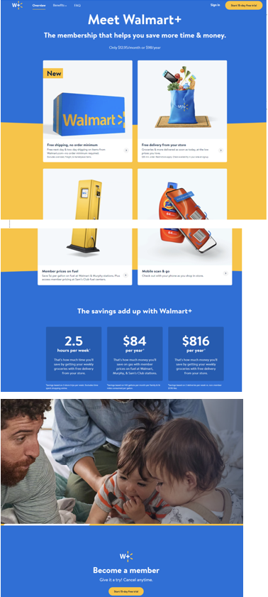
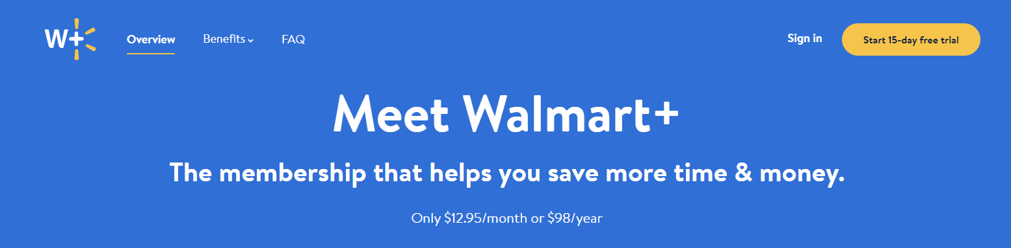

Variable Change: Page Layout
Constant (Control)
Variable (Test) Prototype
Save up to $XXX
Shipping
Delivery
Fuel
Mobile
(description of each with pic)

Slide 6
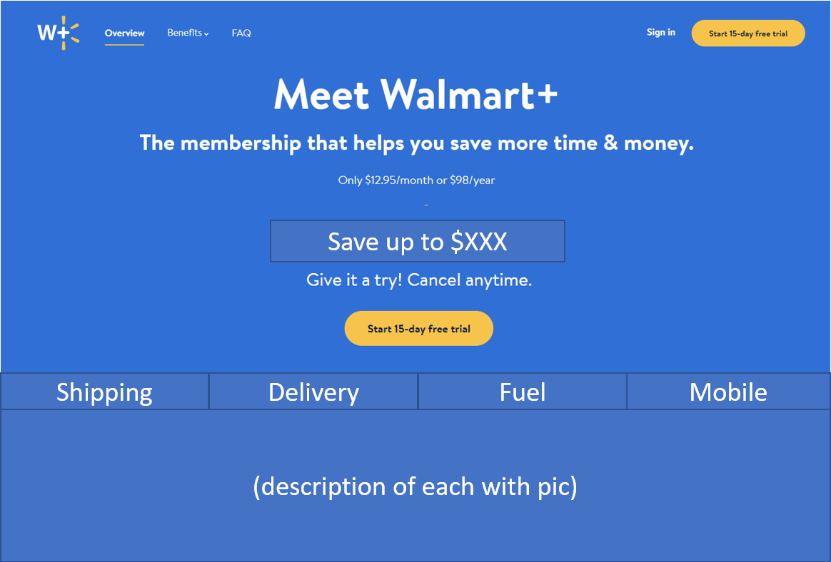
Rationale for Variable Change
Straightforward
Show all in one page.
Let customers know at once.
Easy to understand
Just one number. Don’t
let them think.
Leading
Induce them to click on
free trial button

Slide 7
Metric: Conversion Rate
Conversion Rate
What is the #subscription/#total visitors ratio?
Hypothesis:
Making customers not have to scroll down will
increase subscription rate.

Slide 8
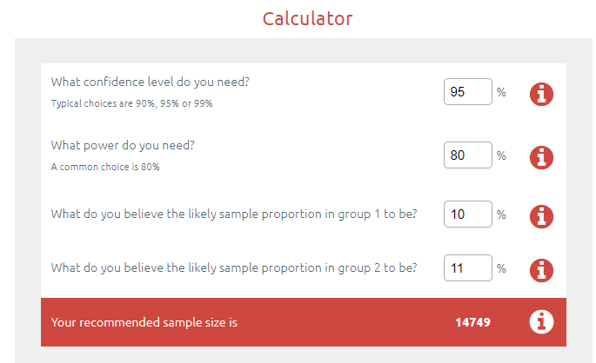
Finding sample size and test time
Assume that
Current subscription rate is 10%
I would like to detect an increase
of at least 10% (from 10% to 11%)
I need at least 14749 visitors for each version (test and control), a total of around 30k visitors
The test time can be calculated if knowing how many visitors per day

Slide 9
Follow-up Test
Repeat AB test but email link of the page to customers with similar profiles and shopping habits (result might vary with different age groups)

Slide 10

Possible Errors with A/B Test
Do not draw conclusions early (small sample size at the beginning)
Do not stop the test even if the significance is reached (test should be run for the whole duration)
Subscription rate may vary on weekdays and weekends (run the test long enough to be accurate)

